Slide 1




billboard top 100 chart predictions model
by: Zeina Mousa

Slide 2


Navigation
Content
Context & Purpose
Data collection
Data overview
Data cleaning
EDA
Visualization
Deployment

Slide 3


Purpose
Context
The data collected will be analyzed to consider each factor in the track to see which have the most influence regarding the track’s position in the chart. With that in mind and the appropriate algorithm chosen the system should be able to accurately predict next week’s chart in regards to each track’s position (with the consideration of new releases)
This dataset is designed to predict the future performance of songs on the charts, including their future rankings, longevity, and peak positions. It also aims to identify the factors influencing each track's chart success.

Slide 4


ATTRIBUTE OVERVIEW | ATTRIBUTE OVERVIEW
chart week | the chart’s date (weekly)
current week | the song’s current position
peak_pos | the song’s peak position
last week | Previous week’s position
performer(s) | the song’s performer(s)
title | the track’s title
wks_on_chart | weeks the song spent in the top 100
Data overview
The data consists of 27700 rows and 14 columns, each column representing an essential factor to the track’s chart position.

Slide 5
ATTRIBUTE OVERVIEW | ATTRIBUTE OVERVIEW
genre(s) | the artist’s typical genre(s)
duration-ms | the song‘s duration in milliseconds
tempo | The estimated tempo of a track in beats per minute
loudness | The overall loudness of a track in decibels (dB) Values typically range between -60 and 0 db
energy | represents a perceptual measure of intensity and activity
danceability | how suitable a track is for dancing
Data overview
The data consists of 27700 rows and 14 columns, each column representing an essential factor to the track’s chart position.

Slide 6





Data Collection
The data collected from various sources
top 100 billboard archive (2020-2025) -github repository
song meta-data -Spotify API
genre(s) -Musicbrainz API

Slide 7
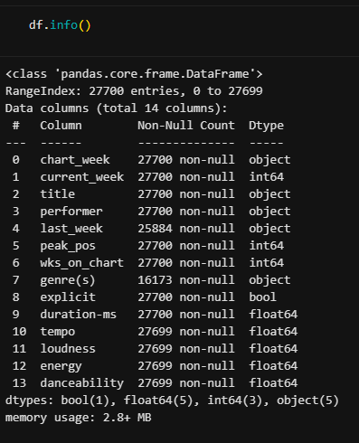



Data overview
info
Major issues
inaccurate data type in two columns:
chart week
last week
missing values
genre(s)

Slide 8
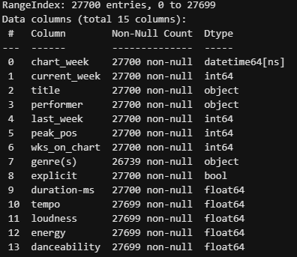

Data Cleaning
info
completed the missing genres values from another website ,Musicbrainz.
fixed the inaccurate missing values
transferred the complete and cleaned file to another csv file to avoid confusion.

Slide 9


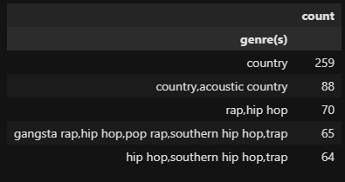
EDA
example
Multiple columns added to facilitate analysis:
Month
Year
month column changed from numeric to nominal to improve readability
The purpose of the EDA process is to figure out the factors affecting each track’s chart position
Top 10 genres in October

Slide 10
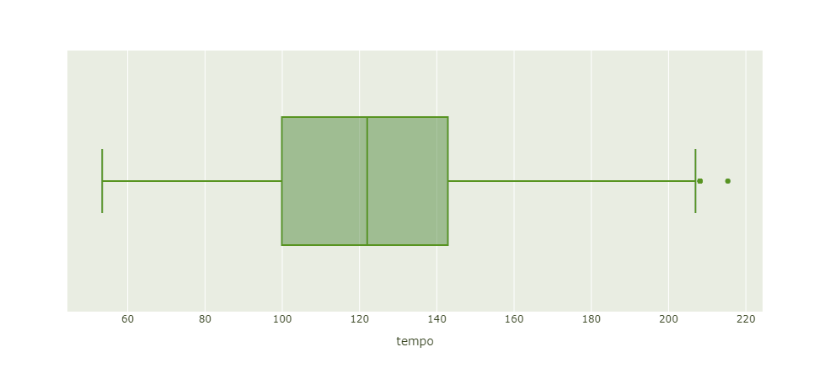

Data Visualization
Aids with identifying patterns, trends, and correlation between attributes
Tempo distribution

Slide 11
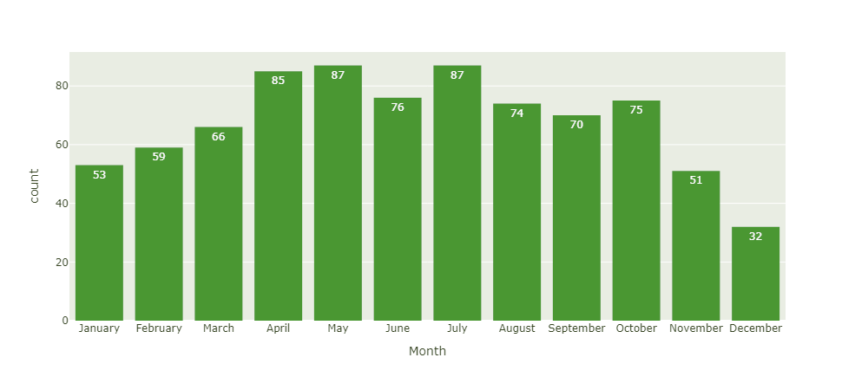
Data Visualization
Aids with identifying patterns, trends, and correlation between attributes
When is rap in the top 10

Slide 12
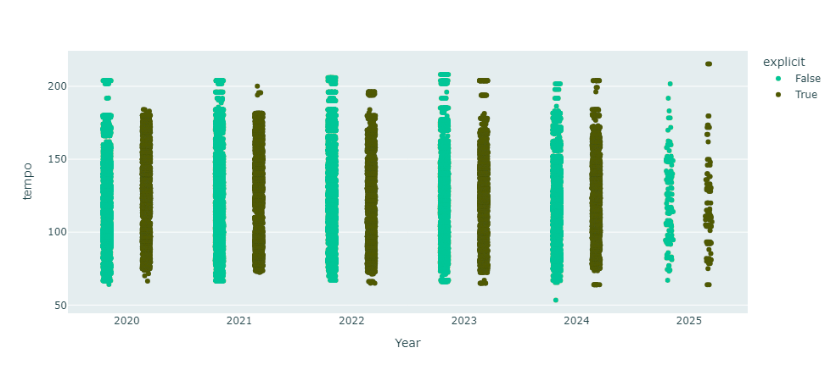
Data Visualization
Aids with identifying patterns, trends, and correlation between attributes
tempo for songs that are explicit and songs that are not for each year

Slide 13
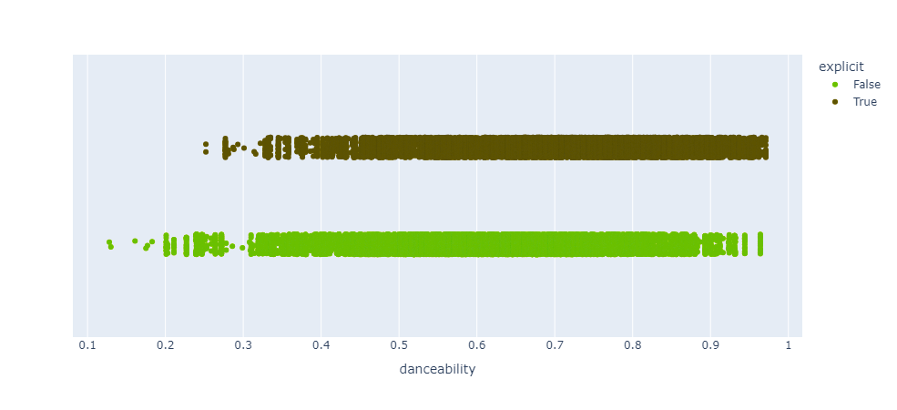
Data Visualization
Aids with identifying patterns, trends, and correlation between attributes
danceability of songs that are explicit and songs that are not

Slide 14
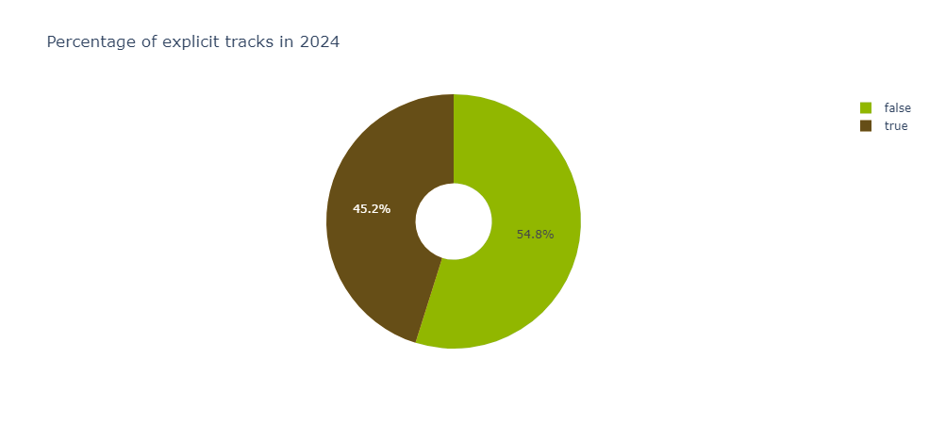
Data Visualization
Aids with identifying patterns, trends, and correlation between attributes
Percentage of explicit songs in
2024

Slide 15
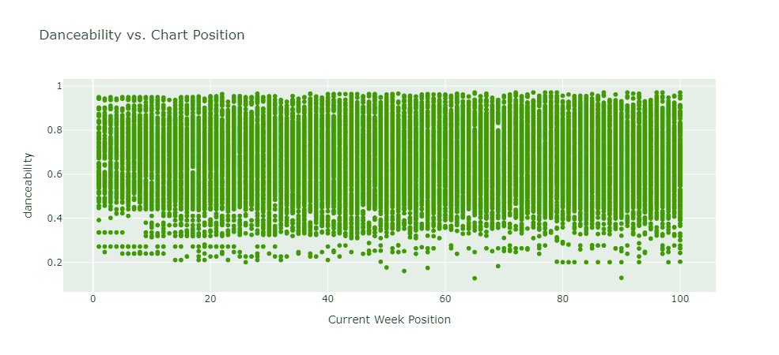
Data Visualization
Aids with identifying patterns, trends, and correlation between attributes
relation between danceability and the track's chart position

Slide 16
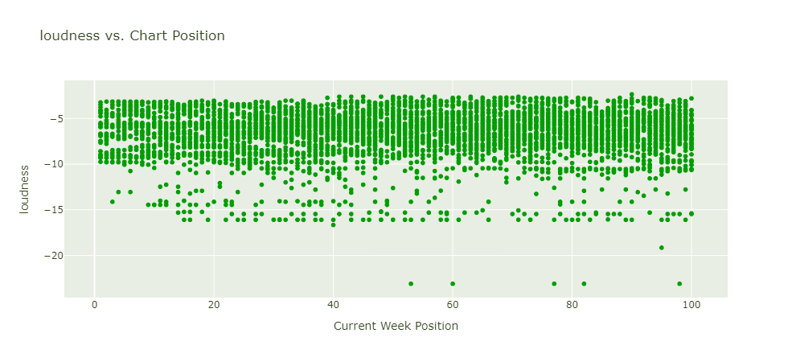
Data Visualization
Aids with identifying patterns, trends, and correlation between attributes
relation between the track's loudness and its chart position (specifically in the year 2020)

Slide 17
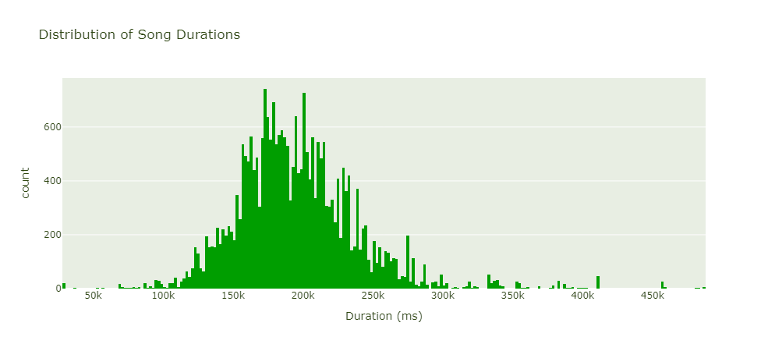
Data Visualization
Aids with identifying patterns, trends, and correlation between attributes
distriution of song durations (with a mask to ignore outliers)

Slide 18
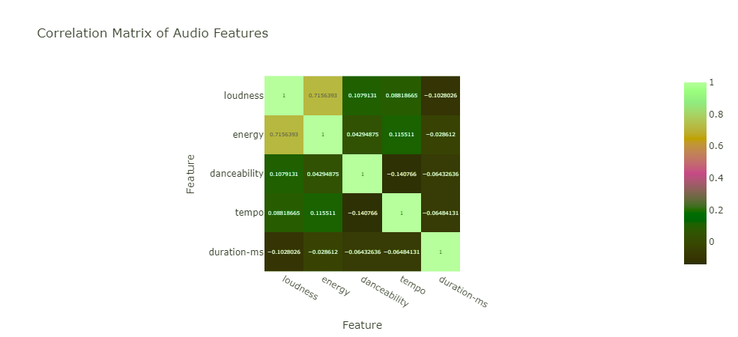
Data Visualization
Aids with identifying patterns, trends, and correlation between attributes
correlation of audio features

Slide 19


Deployment
Transferred the suitable diagrams with various filters for the user to choose from organized accordingly using pages and tabs to ease interpretation
website link:midproject-z.streamlit.app

Slide 20

Thank you

